Slide 1
Employee Data Analysis using Excel
STUDENT NAME: DHARSHAN KUMAR T
REGISTER NO: 312206912/52FCA45F30813F29E4A4F1BD76665D2C
DEPARTMENT: B.COM GENERAL
COLLEGE : A.M JAIN COLLEGE

Slide 2
PROJECT TITLE
Employee Performance Analysis using Excel

Slide 3


AGENDA
Problem Statement
Project Overview
End Users
Our Solution and Proposition
Dataset Description
Modelling Approach
Results and Discussion
Conclusion
3/21/2024 Annual Review

Slide 4

PROBLEM STATEMENT
Employees performance analysis know employees
performance, And to help them by giving incentives to
them. The employee helps us to track whether employees
working effectively or not by rating them.Effective or not.
This performance helps us to growth ourEconomy of our
company.

Slide 5

PROJECT OVERVIEW
• Employees performance analysis is to know
Performance by rating it.
• Create pivot table to analysis what are the
Fields that you going to insert for business
Purpose.
• According to this I have inserted gender wise,
performance rating, business unit, employ first name
For analyzing the performance of employee.
.

Slide 6


WHO ARE THE END USERS?

Slide 7

OUR SOLUTION AND ITS VALUE PROPOSITION
Conditional formatting: it’s ueed find the missing value
Sort &filter: It is used remove missing value and to fill it.
IPS: This formula is used for multiple condition
And to rate the employee performance through this formula
Pivot table: It is used to summarize what we have done.
Graph: This is used for visual

Slide 8
Dataset Description
Employee=kaggle
26 features
9 features
Employ Id : Number
Name: Text
Business unit: Text
Employee type: full time, contract, part time
Performance level: Very high, High,Med,Low
Gender: male, female

Slide 9

THE "WOW" IN OUR SOLUTION
=@IFS(Z3>=5,"VERYHIGH", Z3>=4,"HIGH",Z3>=3," MED", TRUE,"LOW")
3/21/2024 Annual Review
9

Slide 10
MODELLING
Collect the data which you are going to use it.
• Select the column and fill it with color so it can be identified.
• If there is missing number in seIected column use conditional formatting
To fill it. Click on highlight in that more rules click on blank and choose format and click on
the any color that you want to fill on the blanks.
• If you want to identify the missing value click on sort&filter to remove the blanks it
fill the blank. Click on the column which has blank value& click on sort &filter
In that click no fill to remove the blank.
10

Slide 11
Create the performance level for showing rating employee by using the Formula of
=@IFS(Z3>=5,”VERYHIGH”,Z3>=4,”HIGH”,Z3>=3,”MED”,TRUE,”LOW”)Drag the value each every row to apply it
for all.
• To summarize this you have to create pivot table in that enter
Enter business until in rows, performance level in columns, put gender in
Filters and remove the blank in the filter.
• Slicer option is used to know what type of employee are working in the Organizations When click on any type it
generated in the pivot table too.
• Create the graph using the pivot table in that you have trend line show which
Higher whether Very high, High,Med,Low.
• This analysis to find performance of employees .

Slide 12
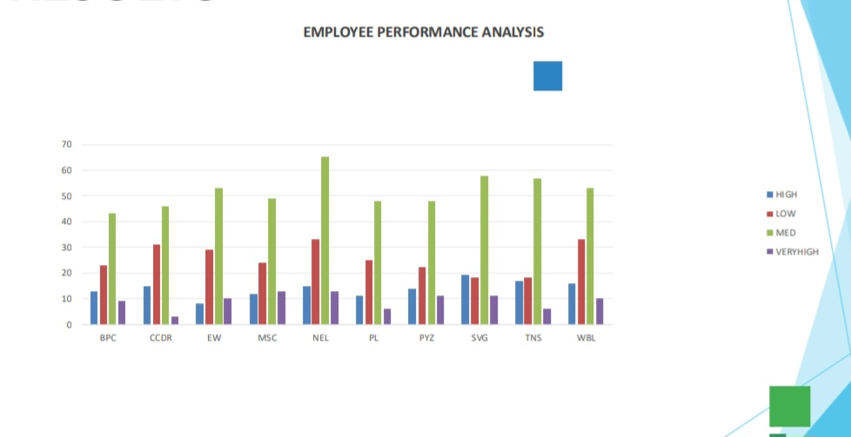
RESULTS
12

Slide 13
conclusion
In this analysis know how we have develop our employee.
• How the performance rating plays an important role in a organisation.

